Slide 1
2026 HLD Grants
“And the Word became flesh and dwelt among us…” John 1:14

Slide 2

Diocese of Raleigh Respect Life Grants
The Respect Life Grants were created in 2000 in the Diocese of Raleigh to support and uphold the sacredness of human life of all persons from conception to natural death, linking life issues in a consistent ethic of life.
Funds are derived from a grant provided by the Diocese of Raleigh, generated by Bishops Annual Appeal funds. The amount available each year is $20,000.
A diocesan Respect Life Grant Committee reviews the grants. Grants are awarded in October.
The grants are available for all groups regardless of religious or non-religious affiliation.

Slide 3
“Local” or Diocesan CCHD Grants
All monies collected for CCHD are used for outreach programs. Seventy-five percent of collected funds are sent to the USCCB (in DC) for national awards to dioceses.
Twenty-five percent of the of the collection is used by the diocese to award grants on a local basis.
A diocesan CCHD Committee reviews the grants. Grants are awarded in October. The grants are available for all groups regardless of religious or non-religious affiliation.

Slide 4

Template Slide for Application Title of Organization, Preferably the Logo (hyperlinked to webpage) -Name of Sponsoring Parish (hyperlinked to their webpage)
Picture (s) of the good work of the organization, especially partnership with parish/Diocese
Mission of Organization
Briefs Points to share with parishioners who support the grant through prayer and donations.
Brief Explanation of what the grant money will be used for
This Space is for Funding source - the BAA Logo for RL grants, the CCHD logo for CCHD grants, see example slides
This Space is for the DoR Logo, see example slides

Slide 5
Example Slides for Application….

Slide 6
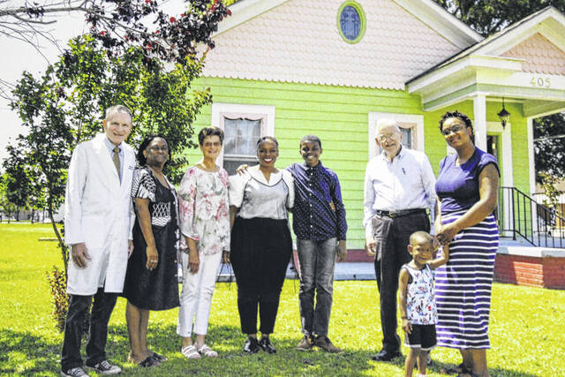
Vita Pregnancy Resource Center -St Mary, Laurinburg
Vita Choices is a prolife organization that aims to meet the needs of women with unplanned or unwanted pregnancies by providing support and guidance on their choices moving forward and their ability or desire to continue the pregnancy
This support is expected not to end with the pregnancy and will extend to the mother and infant post-delivery. Vita Choices is collaborating with local agencies to support both mother and baby in the one to two years after birth.
License for course

Slide 7
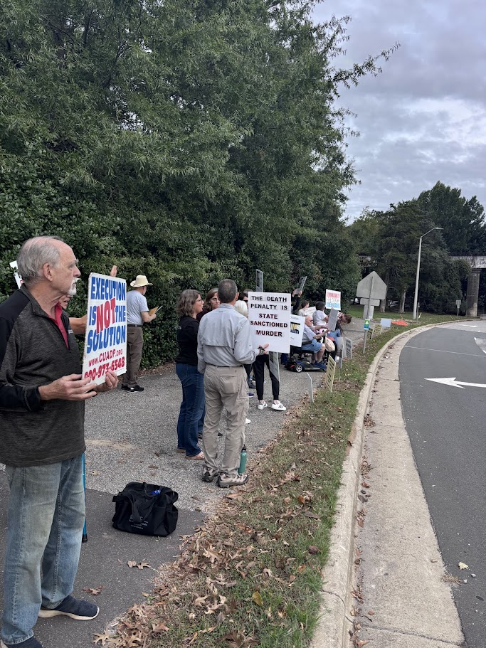
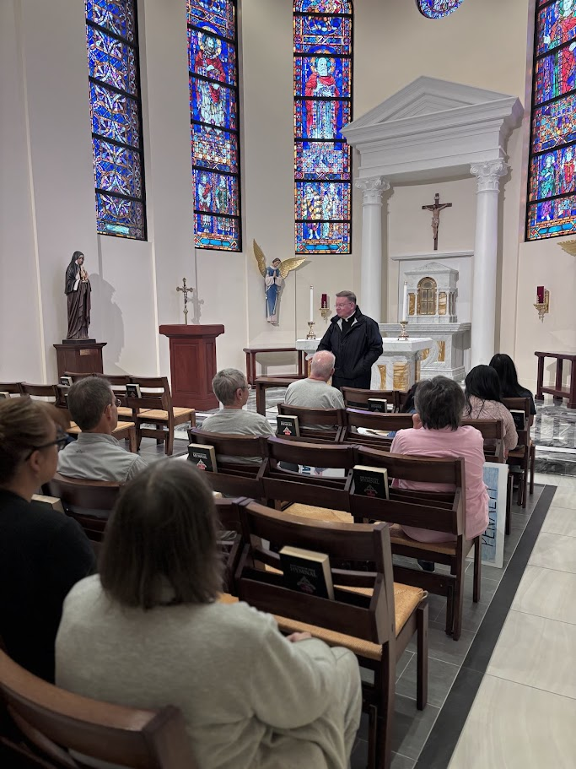

Vision: CANC answers the gospel call to recognize the sanctity of life and abolish the death penalty in NC and in the US.
Mission: In the light of the Gospel, the death penalty is inadmissible because it is an attack on the inviolability and dignity of the person. CANC labors for the abolition of the death penalty in NC by supporting the pillars that build a culture of life.
Prayer and Worship directed to participation in the sacramental life of the Church and in programs of communal and individual prayer, that the culture of death that surrounds us today will be replaced by a culture of life and love.
Education & Formation to deepen understanding of the sanctity of human life, the moral evil of intentionally killing human beings and the mission of the Church to witness to and serve all human life.
Public Policy – advocating for morally acceptable alternatives to the death penalty by contacting elected officials and those running for public office and working alongside other advocacy group.
Pastoral Care – shepherding those who work for abolition, those in prison sentenced to death, and those affected by violent crime and their relatives.
-St Francis of Assisi, Raleigh
Communication growth and Sister Helen Speaking Event

Slide 8
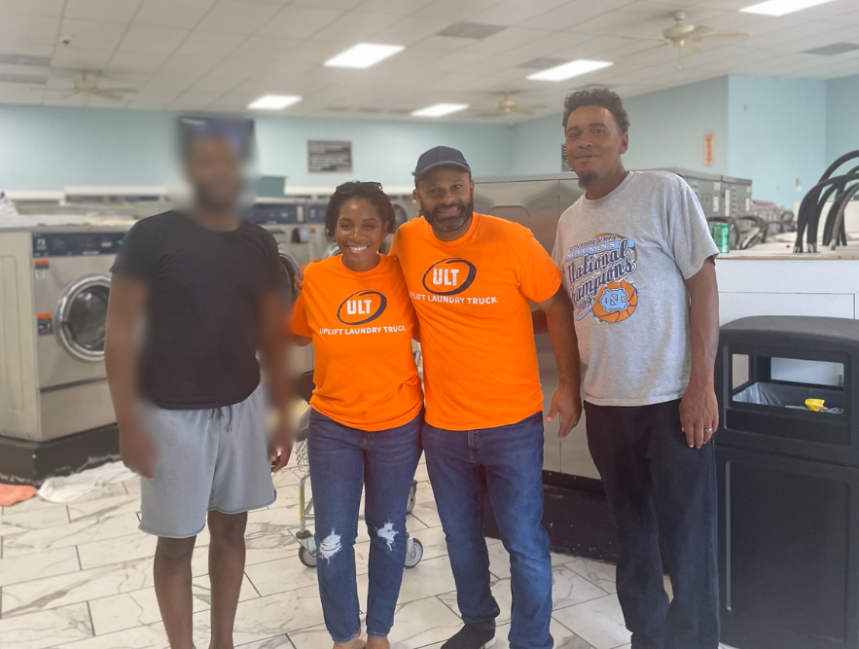
Uplift Laundry -Holy Cross, Durham
Start-up that provides free laundry services and supplies to the low-income and houseless community in the Raleigh/Durham region of North Carolina.
Mission: to provide Free Laundry Services to North Carolina’s 1.4 Million Low-Income Residents.
ULT serves as a Local Women’s Health connection point.
Uplift operates as an advocacy and information portal to connect North Carolina’s women to valuable physical and emotional health resources.
Purchase Washer and dryer

Slide 9
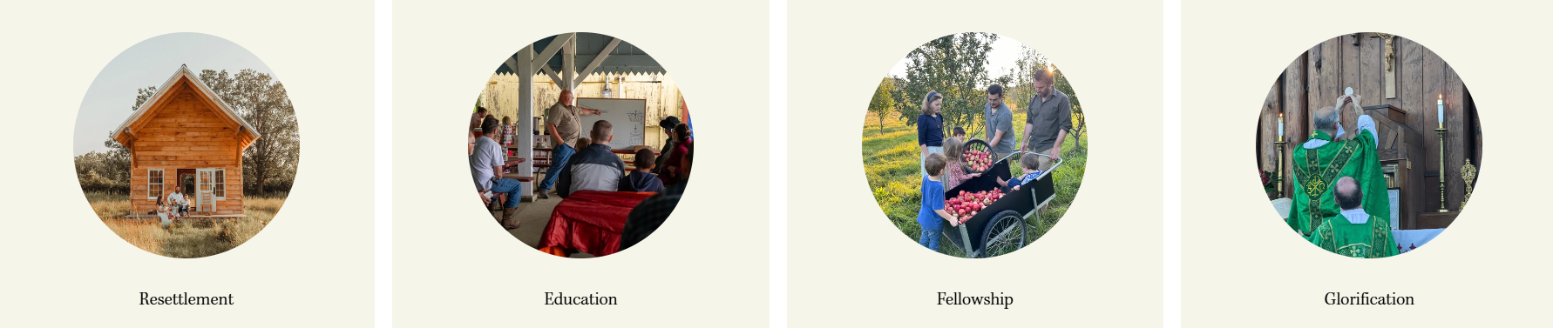
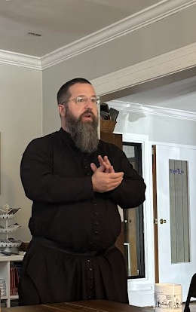
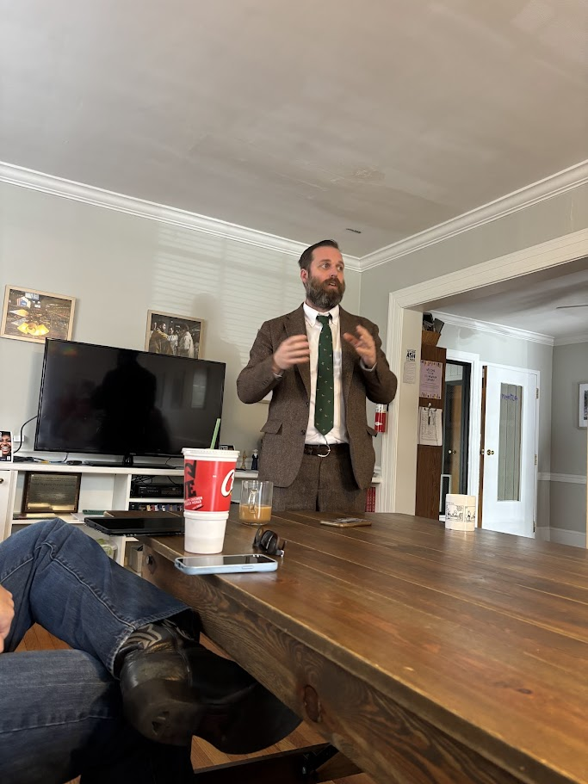
Catholic Land Movement -ECU Newman Center, Greenville
Four Pillars
The Catholic Land Movement exists to facilitate the rural resettlement of Catholics onto productive property which they own.
Many Catholic families yearn for a return to Christ-centered, productive, land-based living — but it often seems impossible. We offer the network, vision, and support to help make it a reality.
Speaker events at ECU and in Raleigh

Slide 10
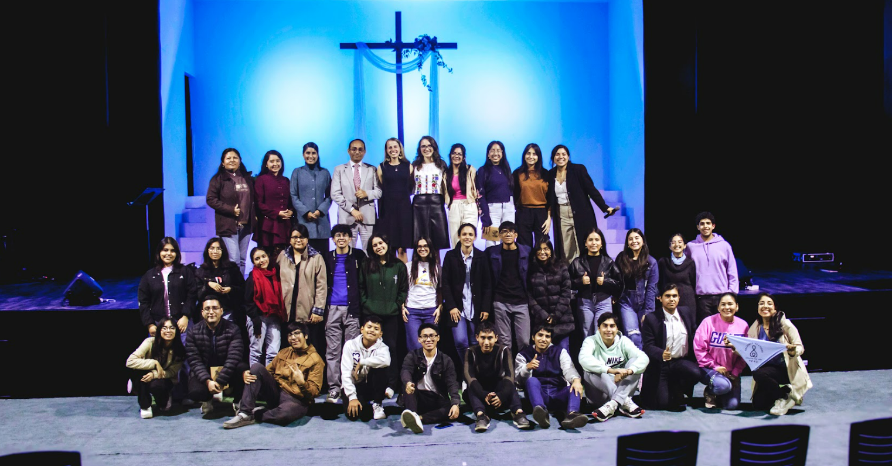
-Duke Catholic Center
Aims to empower and mobilize 73 million LIFESAVERS to protect the 73 million lives lost to abortion each year. We collaborate strategically with local leaders to provide training for students worldwide. Our mission is to inspire the next generation to become LIFESAVERS within their own communities. Currently, we are active in 16 countries, engaging hundreds of students in thousands of conversations on their campuses. Thanks to our Lifesaver practicums, over 500 babies have been saved!
Funds for Lifesaver Practicum

Slide 11
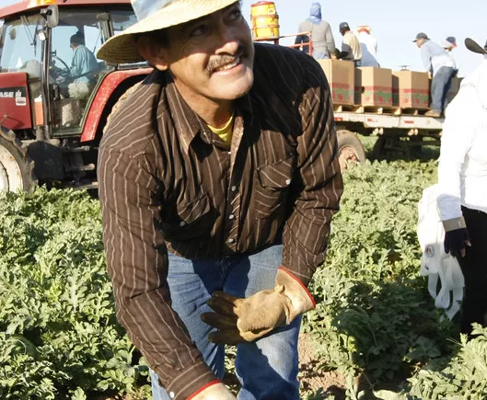
St. Ann, Clayton Migrant Ministry
Mission
Responding to God’s call to serve Him in our diverse community, in union with the Bishop of Raleigh and the Holy Father, the daily priority of St. Ann Catholic Church Migrant Ministry is to:
Proclaim the Good News of Jesus Christ by word and deed
Celebrate the presence of God through the Eucharist and prayer
Build up the body of Christ by welcoming all who worship with us by seeking new members
Respond to the spiritual and material needs of those among us
Spanish Bibles

Slide 12
Template Slide for Grant Report Title of Organization and Grant Project, with Parish Sponsor CCHD or RL 2025 Grant Report
What was accomplished
Include photos (blur faces if minor or do not have permission)
Include explanation of funds used
Photo(s)

Slide 13
Example Slide for Grant Report…

Slide 14
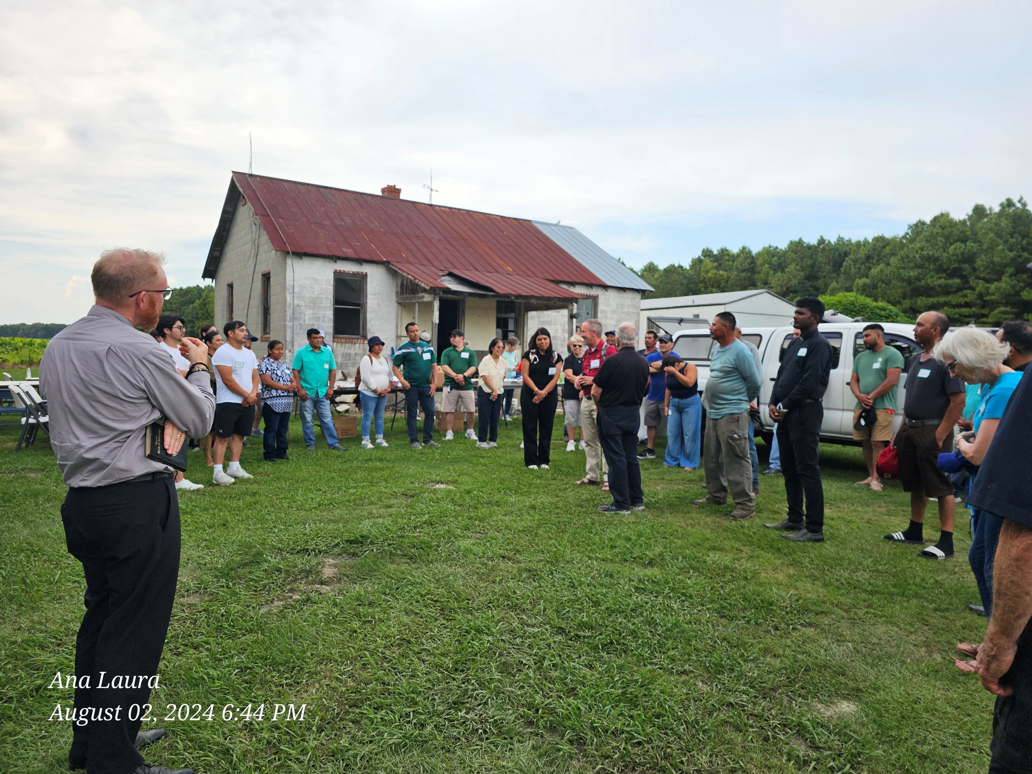
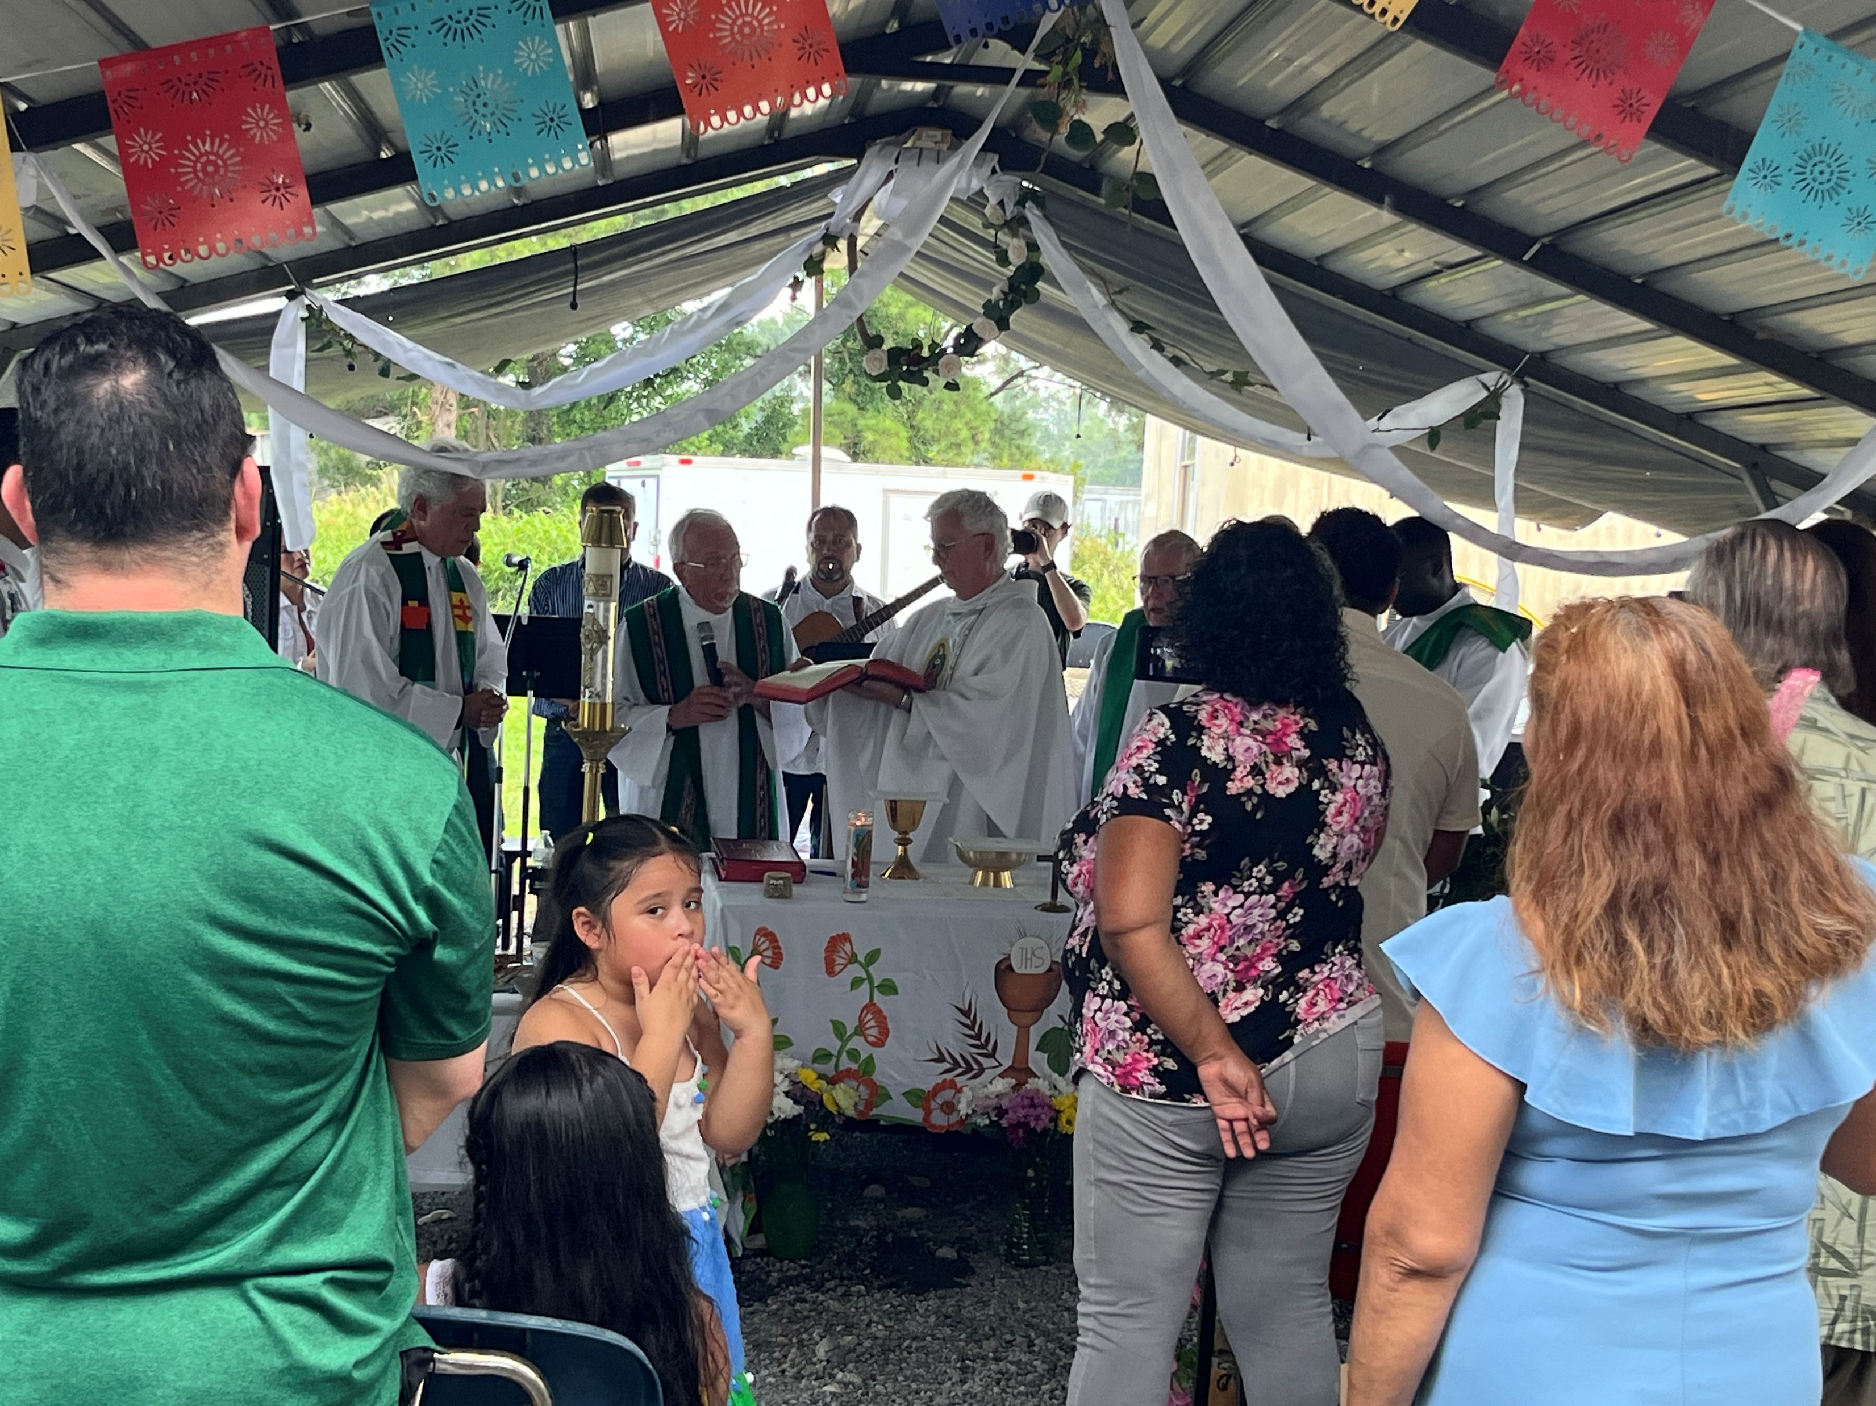
CCHD Grant Report St. Ann, Clayton Migrant Ministry CCHD 2025 Grant Report
Purchased Bibles
St Ann was able to visit 4 camps and pass out 50 Spanish Bibles to the Farmworkers at various events, including Masses in the fields

