Slide 1
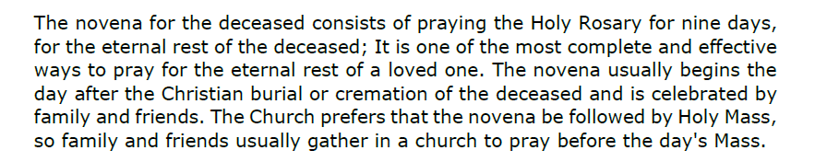
Guide-How to pray a novena for the deceased

Slide 2
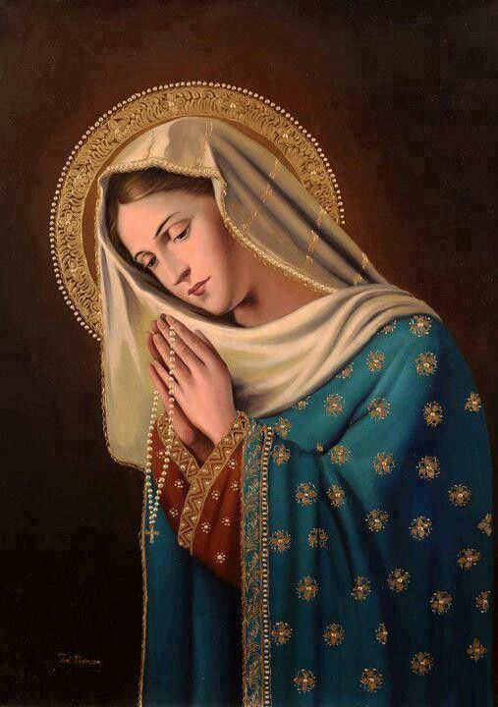
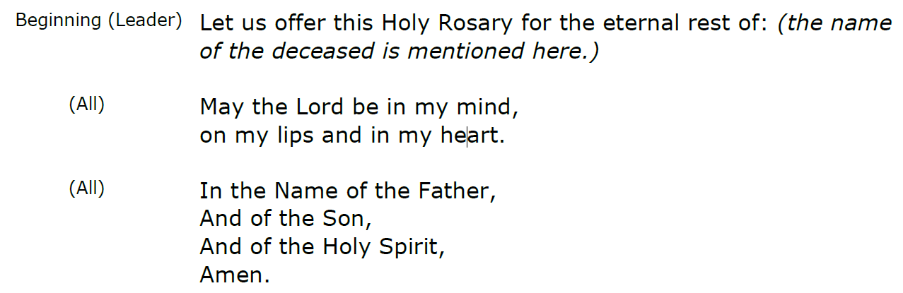
Holy Rosary
(name of the deceased is mentioned here)

Slide 3
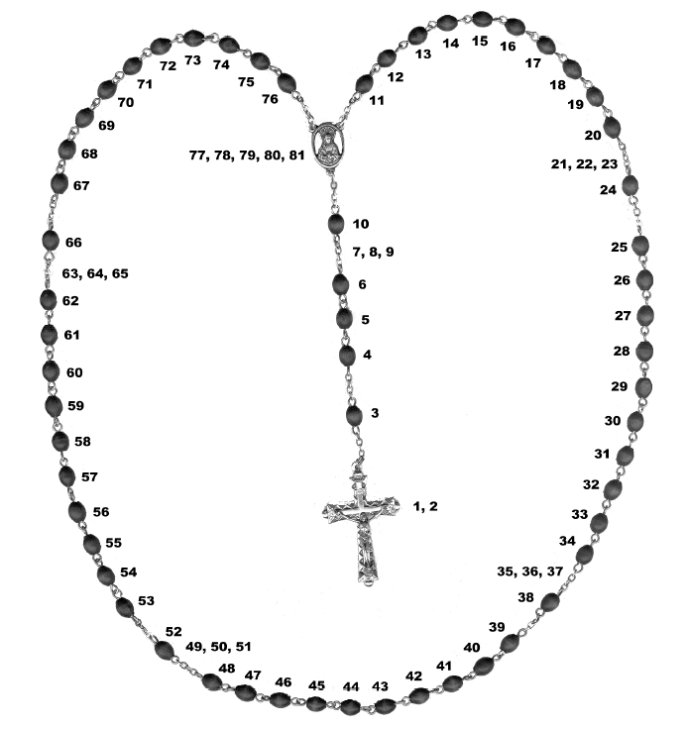
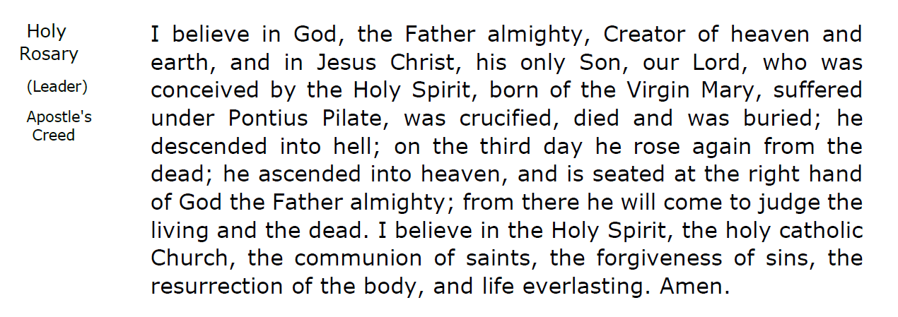
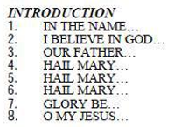

Slide 4
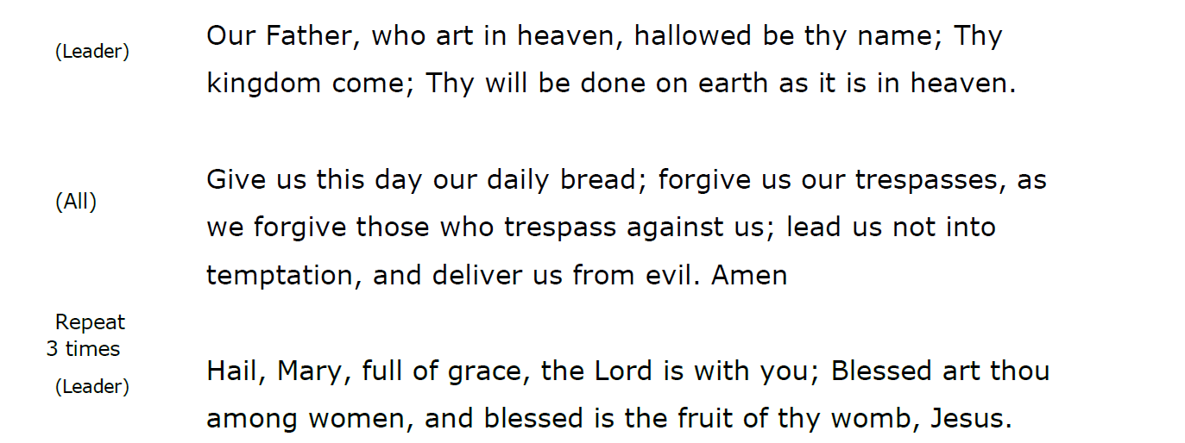
1
2
3

Slide 5
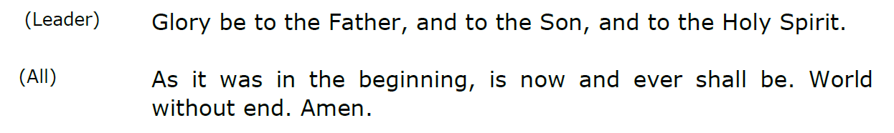
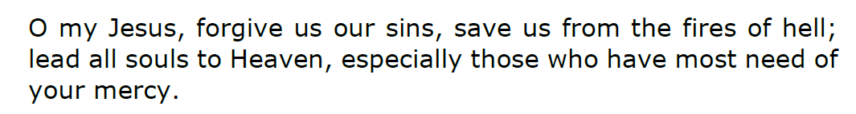
(All)

Slide 6
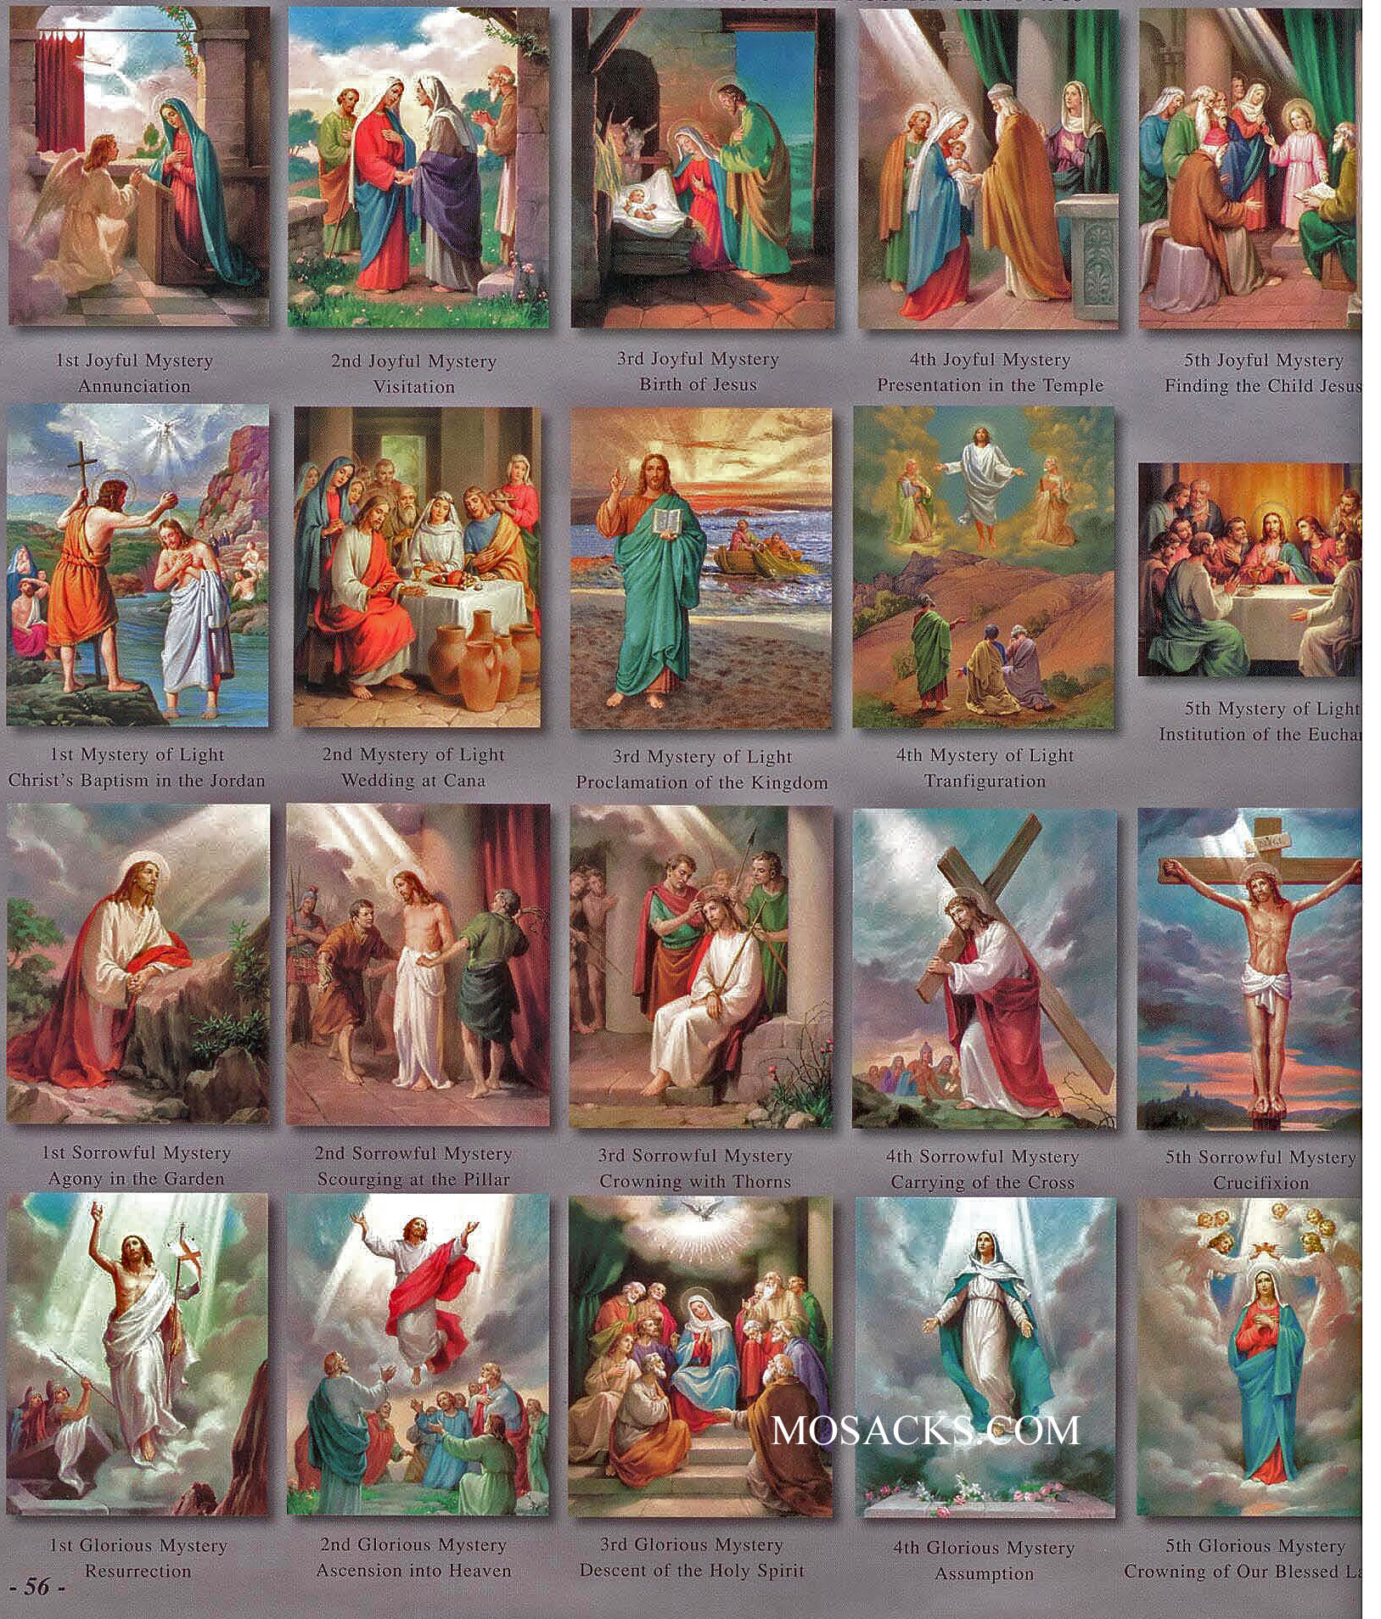
First Mystery
Joyful (Monday & Saturday): The Annunciation of the Angel to the Virgin Mary
Sorrowful (Tuesday & Friday): The Agony in the Garden
Glorious (Wednesday & Sunday): The Resurrection of Our Lord Jesus Christ
Luminous (Thursday): The Baptism of Christ in the Jordan

Slide 7
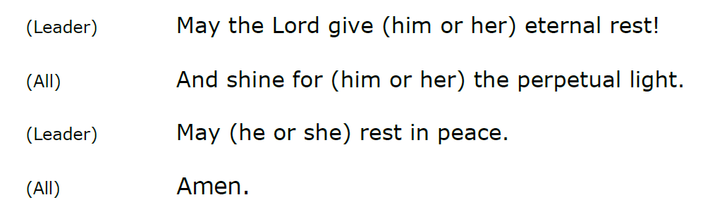

Slide 8
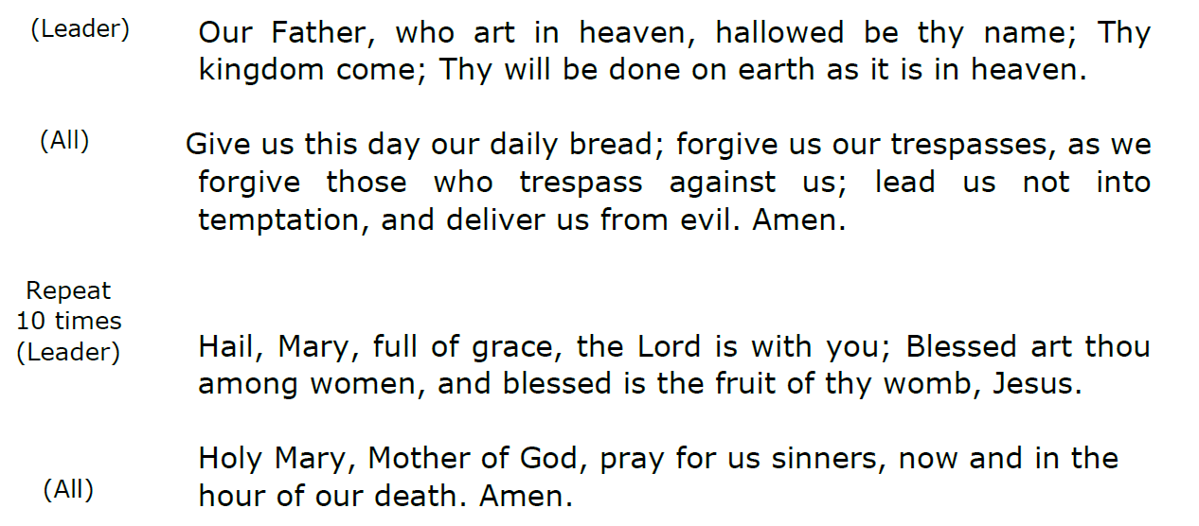
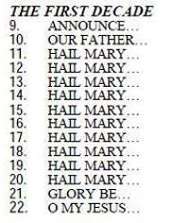
1
2
3
4
5
6
7
8
9
10

Slide 9
(All)

Slide 10
Second Mystery
Joyful (Monday & Saturday ): The Visitation
Sorrowful (Tuesday & Friday): The Scrouging at the Pillar
Glorious (Wednesday & Sunday): Our Lord’s Ascencion into Heaven
Luminous (Thursday): The Wedding Feast at Cana

Slide 12
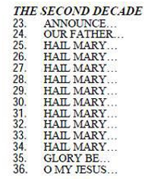
1
2
3
4
5
6
7
8
9
10

Slide 13
(All)

Slide 14
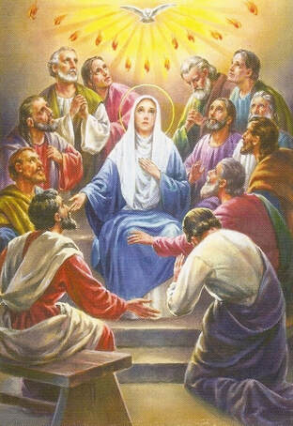
Third Mystery
Joyful (Monday & Saturday ): The Birth of Our Lord Jesus Christ
Sorrowful (Tuesday & Friday): The Crowing with Thorns
Glorious (Wednesday & Sunday): The Descent of the Holy Spirit
Luminous (Thursday): Jesus’ Proclamation of the Coming of the Kingdom of God

Slide 16
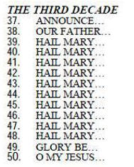
1
2
3
4
5
6
7
8
9
10

Slide 17
(All)

Slide 18
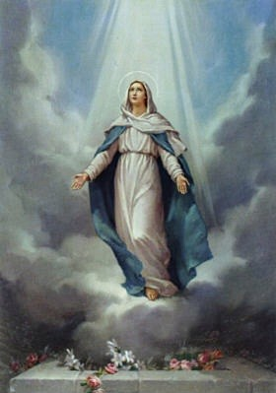
Fourth Mystery
Joyful (Monday & Saturday ): The Presentation of the Child Jesus in the Temple
Sorrowful (Tuesday & Friday): The Carrying of the Cross
Glorious (Wednesday & Sunday): The Assumption of Mary
Luminous (Thursday): The Transfiguration

Slide 20
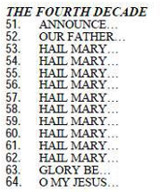
1
2
3
4
5
6
7
8
9
10

Slide 21
(All)

Slide 22
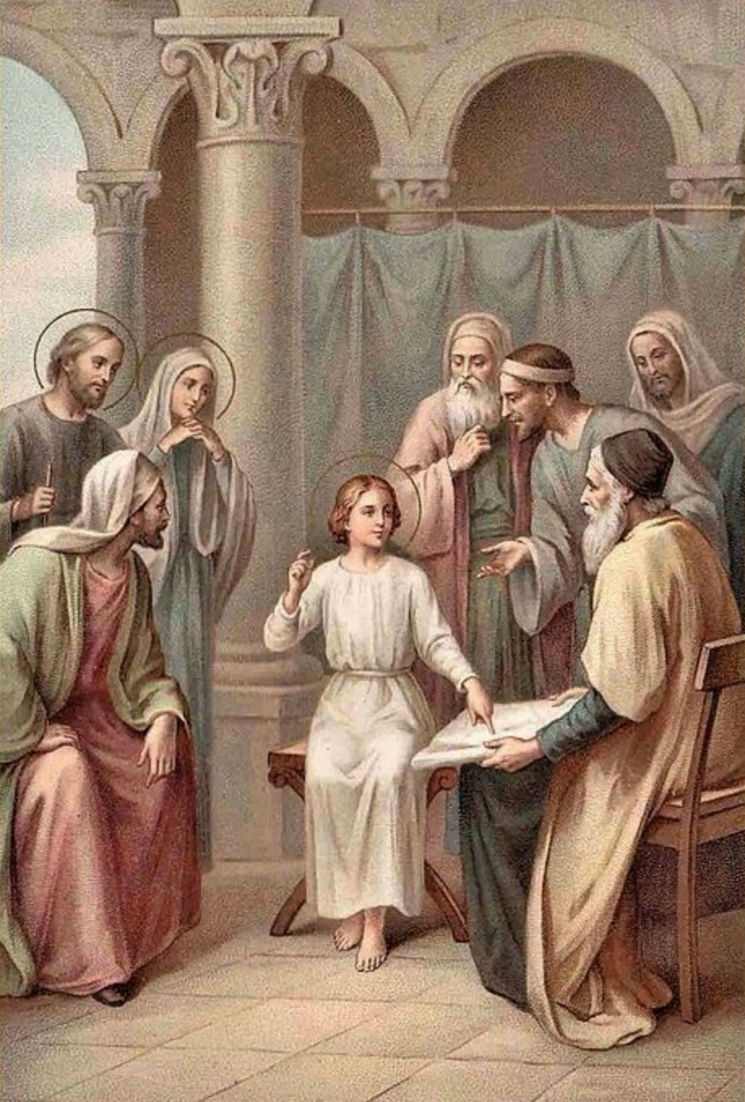
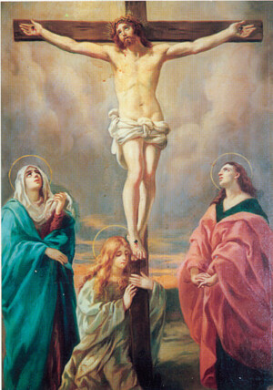
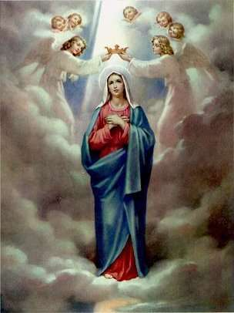
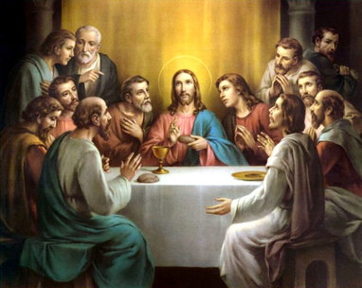
Fifth Mystery
Joyful (Monday & Saturday ): The finding of Jesus in the Temple
Sorrowful (Tuesday & Friday): The Crucifixion and Death of Our Lord Jesus Christ
Glorious (Wednesday & Sunday): The Coronation of Mary Most Holy as Queen and
Lady of all creation
Luminous (Thursday): The Institution of the Eucharist
5th Mystery of Light
Institution of the Eucharist
5th Joyful Mystery
Finding the Child Jesus
5th Sorrowful Mystery
Crucifixion
5th Glorious Mystery
Crowning of Our Blessed Lady

Slide 24
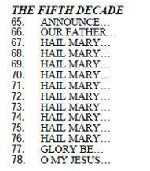
1
2
3
4
5
6
7
8
9
10

Slide 25
(All)

Slide 26
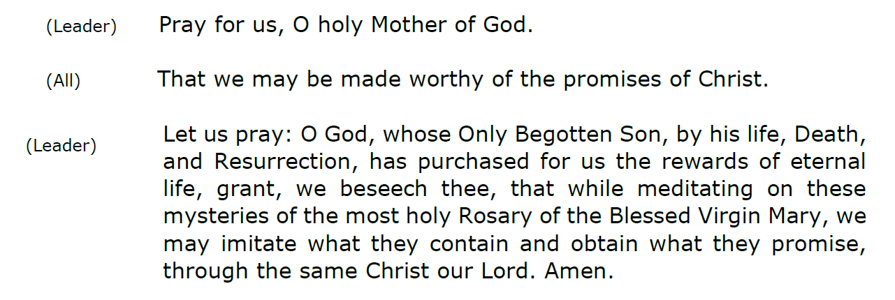


Slide 27
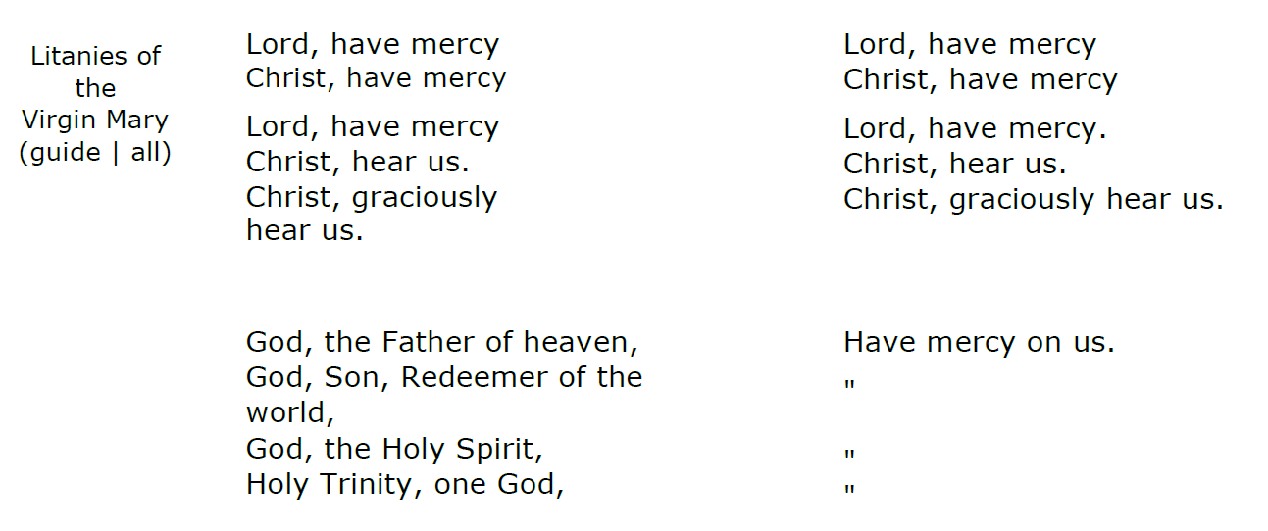
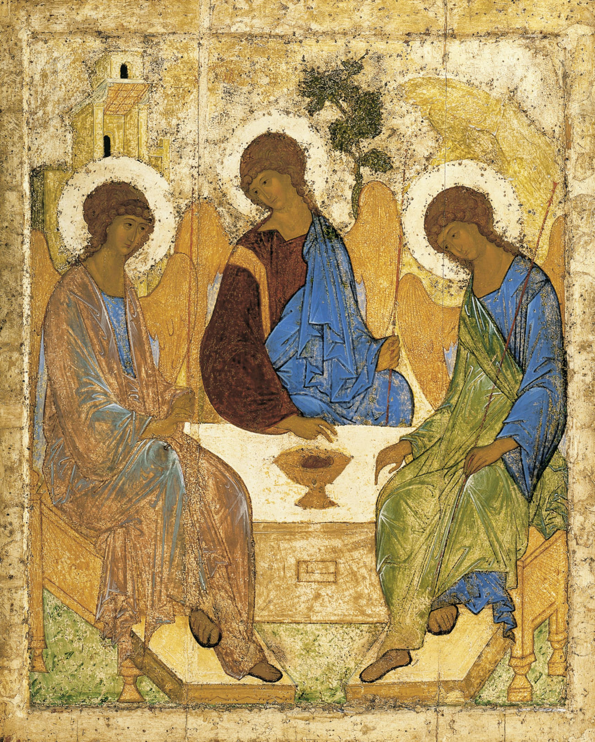

Slide 28
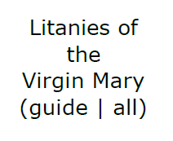
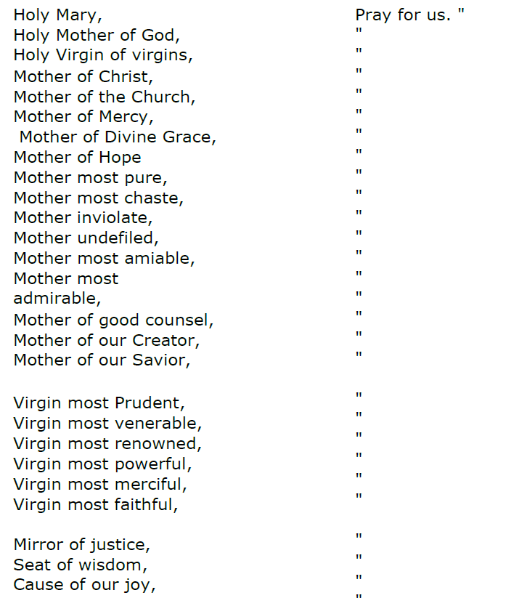
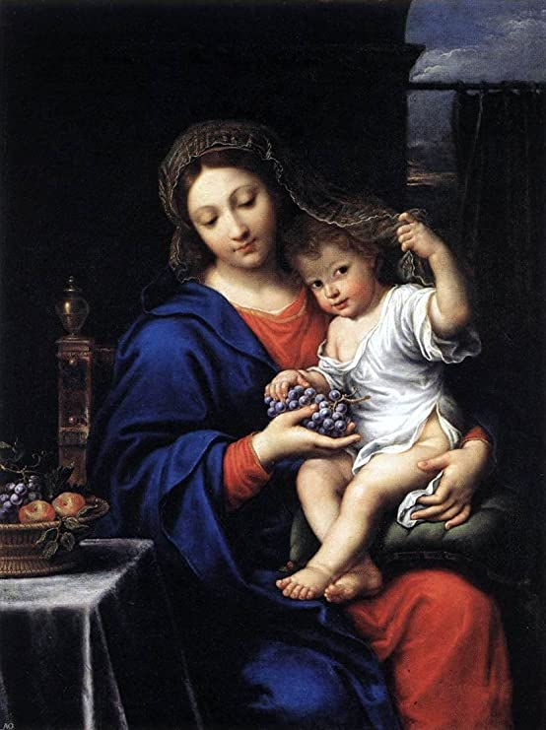

Slide 29

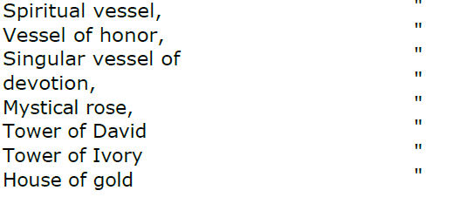
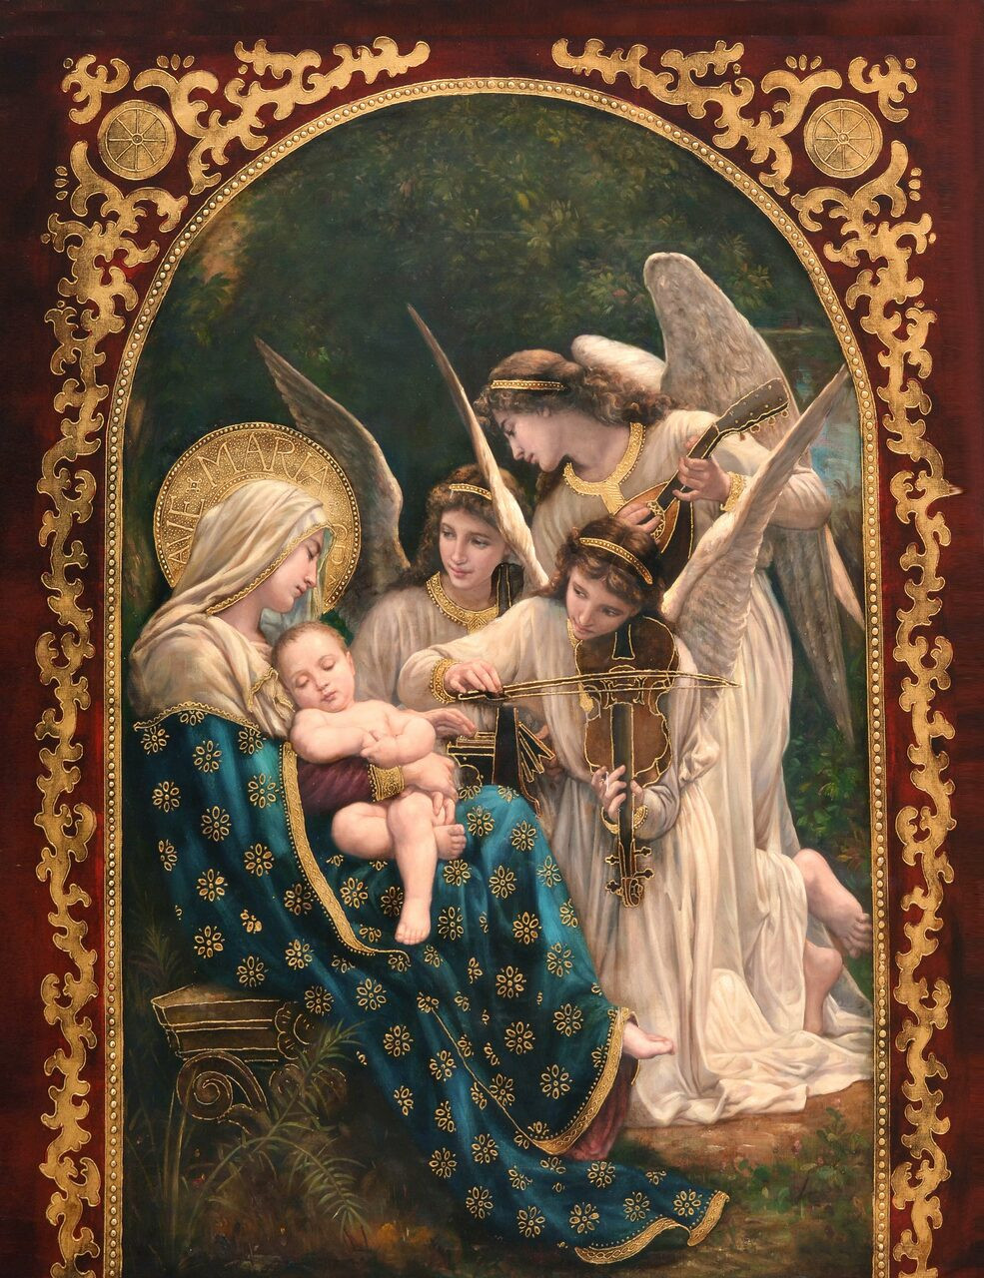
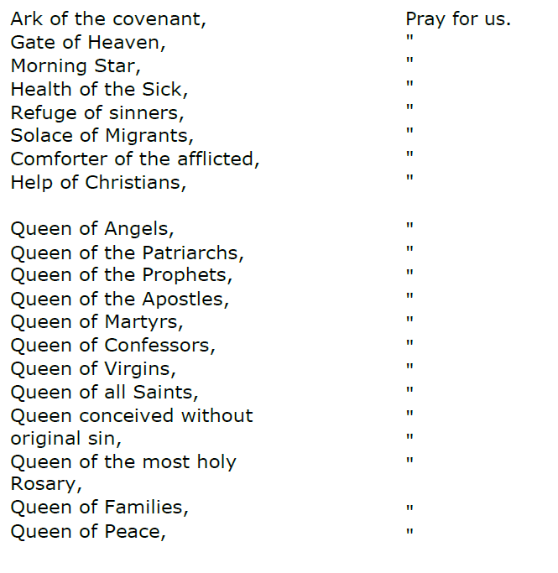

Slide 30
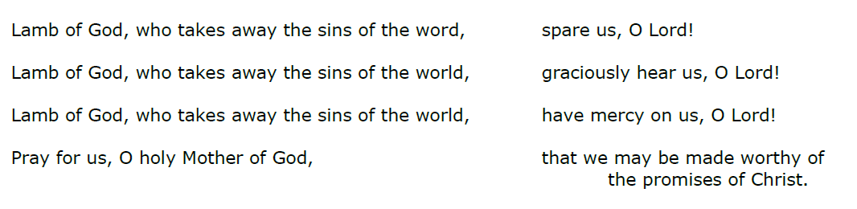
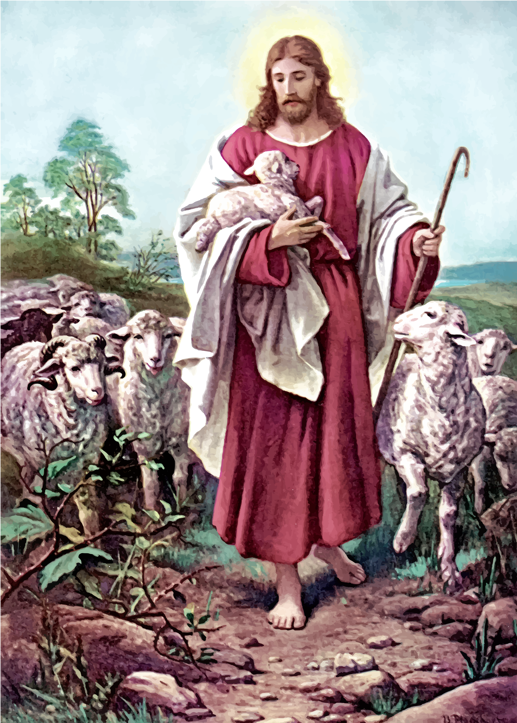

Slide 31
